Slide 1
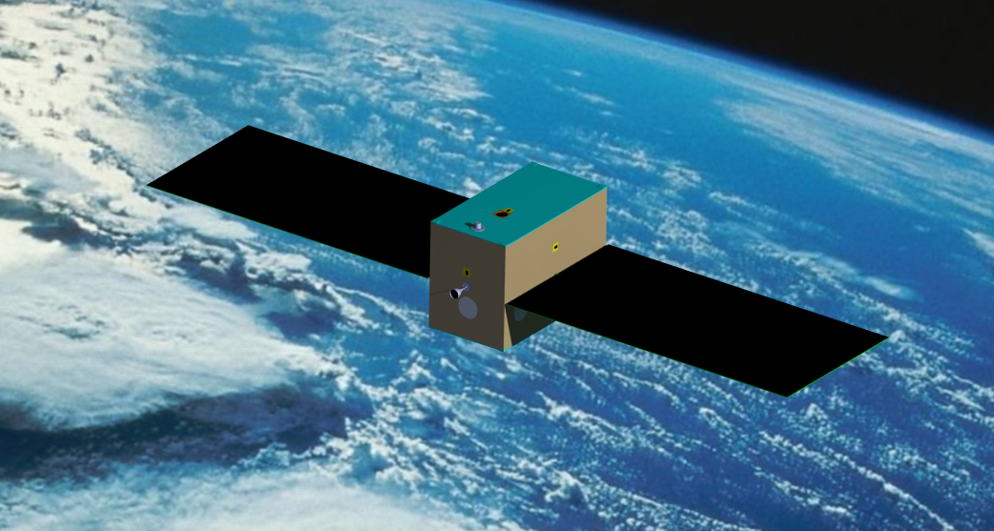

Emitter Satellite
afbeelding
I_{xx} = 2.407 kgm²
I_{yy} = 5.582 kgm²
I_{zz} = 6.542 kgm²

Slide 2
Volumes, Masses and Prices Emitter
Emitter | Number | Dimensions | Mass | Price [EUR]
Sun sensors | 5 | 30x30x14.5 mm³ | 120 | 55000
Star tracker | 1 | 50x50x100 mm³ | 375 | 75000
Reaction wheels | 3 | 90x90x20 mm³ | 135 | 550
Magneto torquers | 3 | 20x20x150 mm³ | 600 | 9000
Thruster (incl. tanks, etc.) | 1 | 300x200x100 mm³ | 1650 | 400000
Total |  |  |  | 540000

Slide 3
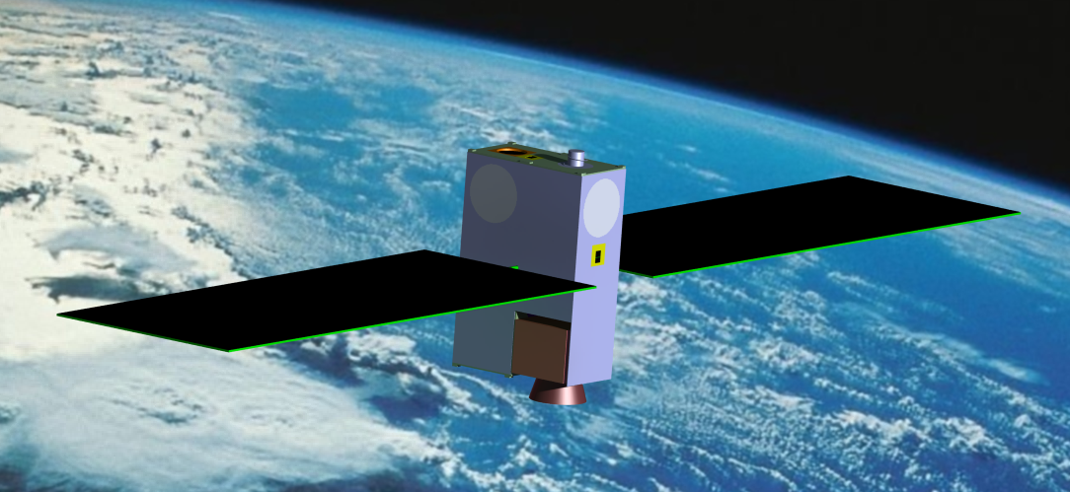
Receiver Satellite
I_{xx} = 1.307 kgm²
I_{yy} = 0.101 kgm²
I_{zz} = 1.316 kgm²

Slide 4
Volumes, Masses and Prices Receiver
Emitter | Number | Dimensions | Mass | Price [EUR]
Sun sensors | 4 | 30x30x14.5 mm³ | 120 | 44000
Star tracker | 1 | 50x50x100 mm³ | 375 | 75000
Reaction wheels | 3 | 45x45x15 mm³ | 135 | 550
Magneto torquers | 3 | 9x9x70 mm³ | 600 | 3450
Thruster (incl. tanks, etc.) | 1 | 100x100x150 mm³ | 1650 | 250000
Total |  |  |  | 540000

